Slide 1


SOUL - Robotiva Competition
Presented by:
Omar Ayman Mohamed
Moataz RafEk Hamdy
Adham Abd El-Fattah
Hazem Abd El-Fattah

Slide 2
Problem
In various industries, automation faces challenges in performing multiple tasks efficiently.
Main issues identified:
In warehouses, robots need to follow lines for effective navigation.
Obstacle avoidance is crucial in dynamic environments to prevent collisions.
Pick-and-place tasks require precision for handling materials.
Current solutions:
Tend to be single-functional, requiring multiple robots for different tasks.
High costs make them less accessible to smaller industries and educational sectors.

Slide 3
Solution
Introducing the SOUL Robot – a versatile, cost-effective robotic solution.
Key Capabilities:
Line Following: Ensures accurate and stable navigation.
Obstacle Avoidance: Detects and navigates around obstacles efficiently.
Pick-and-Place Operations: A six-joint robotic arm handles objects precisely.
Control System:
Operated via a Bluetooth-connected mobile application.
Allows users to switch between different modes seamlessly.

Slide 4
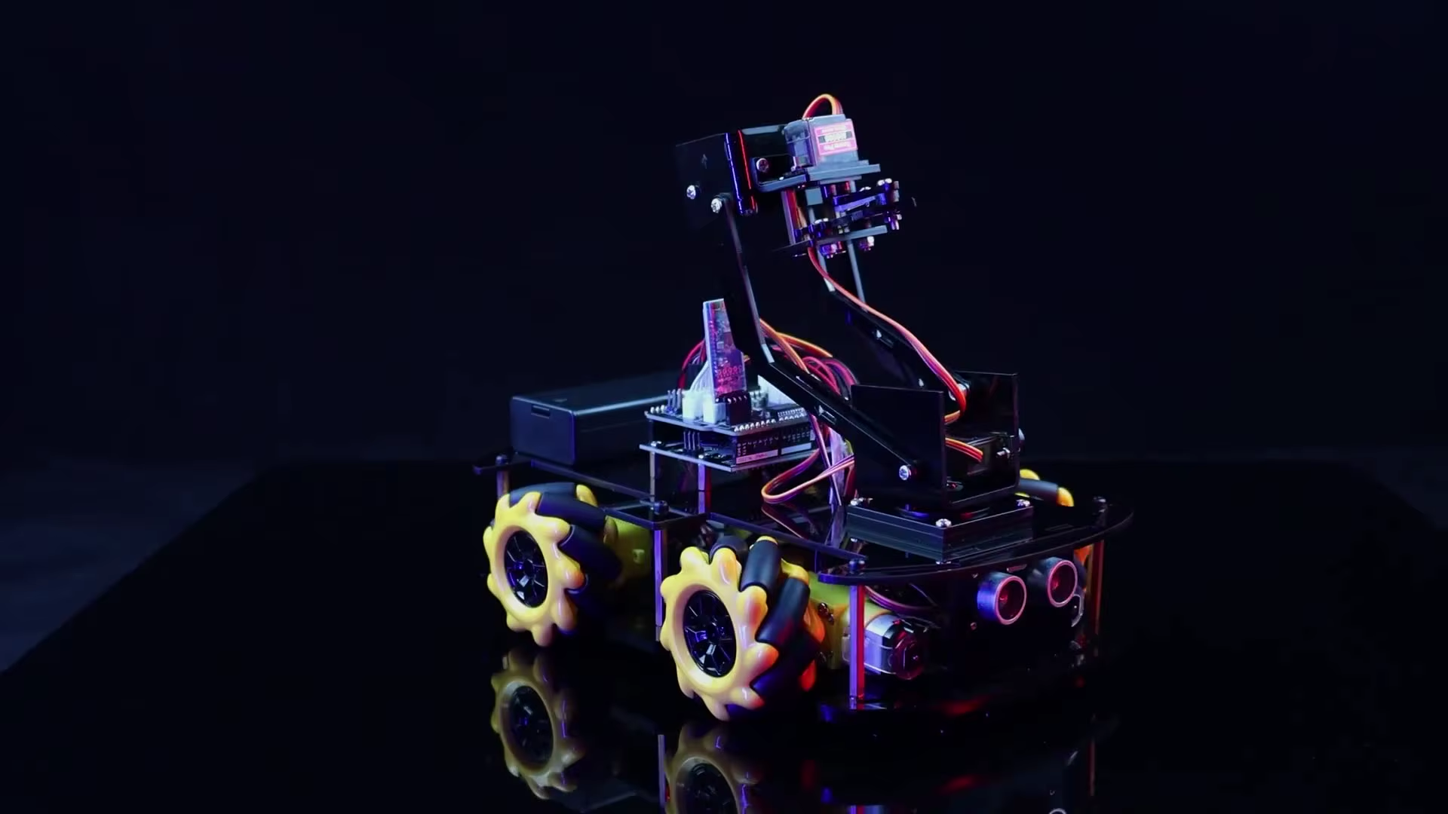



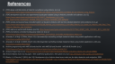
4. Financials - Income & Expenses
5. Conclusion
3. Competition
1. Prototype Overview
2. Business Model Canvas (BMC)

Slide 5
Prototype Overview
The SOUL Robot is designed to meet the Robotiva competition's three primary challenges.
Features:
Line Following: Utilizes a 5-channel IR sensor array for accurate tracking.
Obstacle Avoidance: Uses an ultrasonic sensor mounted on a servo for 180° scanning.
Pick-and-Place Arm: A 6-DOF robotic arm capable of lifting and placing objects.
Control & Operation:
Managed through an Arduino board and Bluetooth communication.
Software-based switch mode enables selecting the desired functionality.

Slide 6

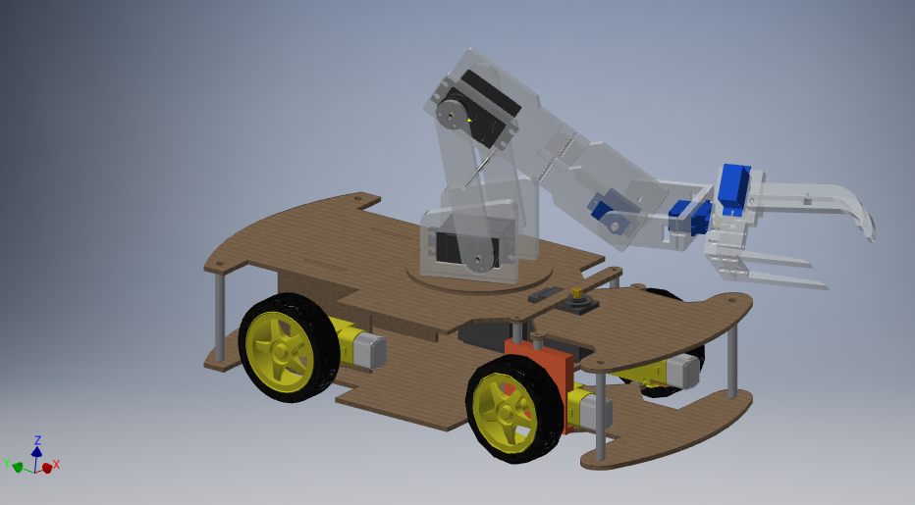
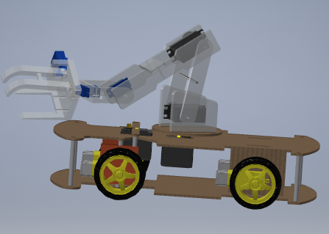
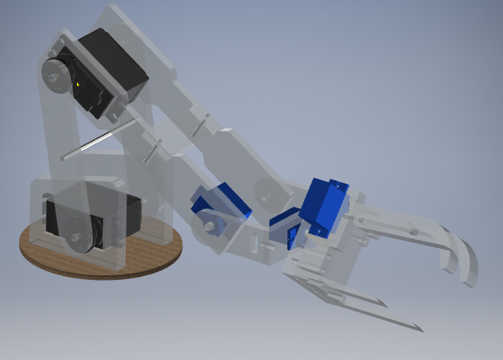
Prototype Design

Slide 7
Prototype Architecture
Power Sources:
Primary Source (12V): Powers the L298N motor driver, four DC motors for mobility, and the Arduino.
Secondary Source (8V): Dedicated to powering the six-servo robotic arm, ensuring stable performance.
Core Components:
Arduino Uno: Acts as the central control unit, processing sensor data and controlling actuators.
HC-05 Bluetooth Module: Facilitates wireless communication with the mobile application.
L298N Motor Driver: Handles the operation of four DC motors for smooth movement.
IR Sensor Array: Five sensors detect line paths for navigation.
Ultrasonic Sensor (with Servo): Provides obstacle detection through environmental scanning.
6-DOF Robotic Arm: Performs pick-and-place operations with precision.
Modular Design:
Software-based mode switching ensures efficient use of hardware components.
Easy scalability for future upgrades or added functionalities.

Slide 8
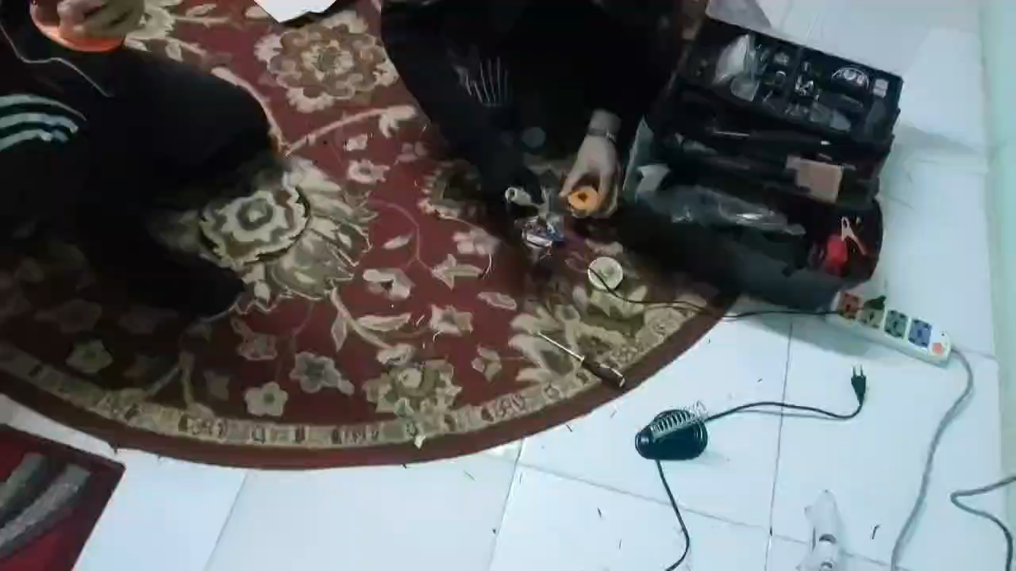

Slide 9
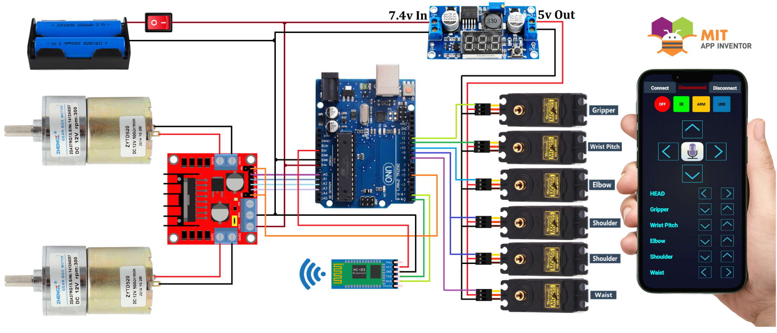
MOBILE APPLICATION AND CONNECTIONS

Slide 10
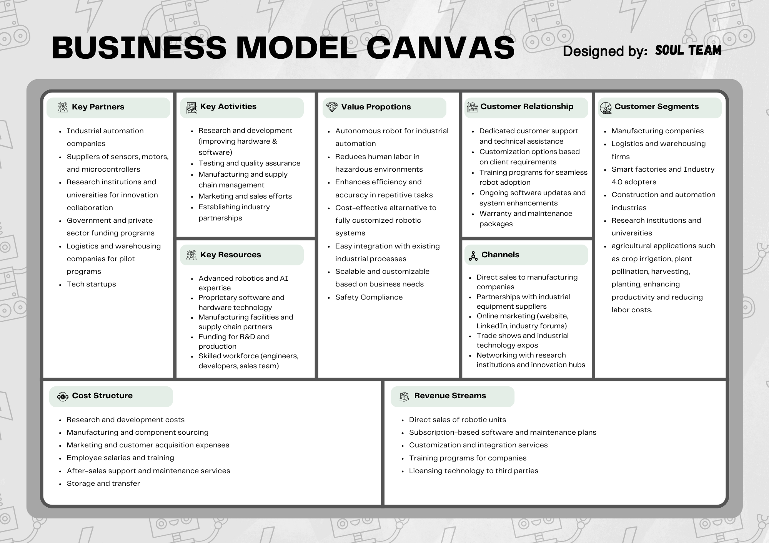

Slide 11
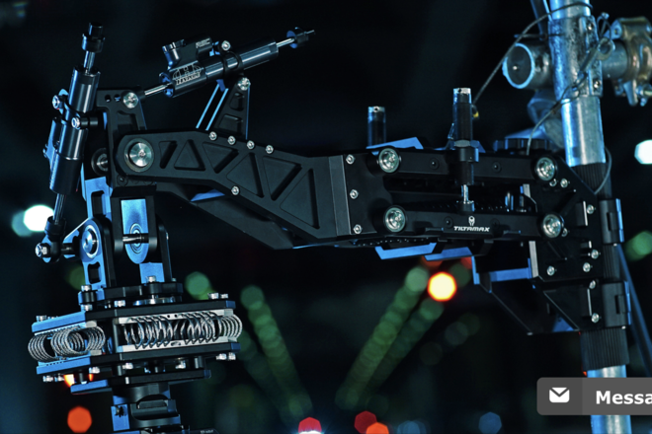
Competition
Competitive Analysis:
Most competitors provide single-function robots that are costly and less adaptable.
SOUL Robot: Offers three core functionalities in one unit, reducing overall costs for users.
Advantages of SOUL Robot:
Multi-functional and cost-effective.
Modular and easy to maintain.
User-friendly with Bluetooth control.
High durability with robust materials.

Slide 12

Financials - Income & Expenses
Income Sources:
Robotiva competition funding and potential prizes.
Future sales of the prototype to educational and industrial sectors.
Customization services for specific client requirements.
Expenses:
Hardware: EGP 2,500 (components, motors, sensors, and controllers).
Development: EGP 500 (software development, testing).
Miscellaneous: EGP 206 (wiring, connectors, chassis materials).
Total Cost: EGP 3,206
Cost Optimization Strategies:
Reduced Arduino boards from two to one without compromising functionality.
Optimized battery usage, lowering overall cost and weight.
Projected Revenue: Expected to break even with potential sales after the competition.

Slide 13
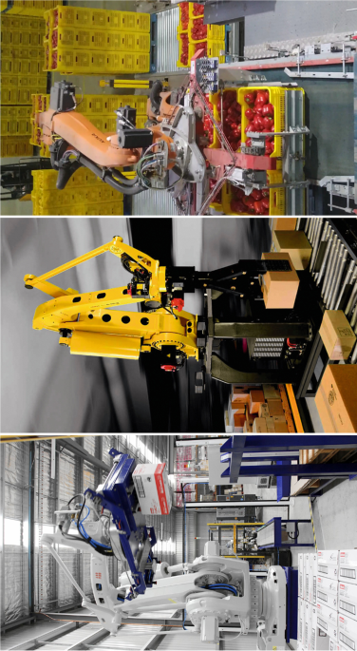
Use Cases in Real Life
Warehouse Automation:
Transporting items along pre-set paths with obstacle avoidance.
Agriculture:
Possible adaptations for crop monitoring, planting, and harvesting.
Manufacturing:
Assisting in assembly lines with pick-and-place operations.
Healthcare:
Moving medical supplies safely and efficiently.
Education:
Teaching robotics, programming, and automation concepts.

Slide 14

Conclusion
Key Takeaways:
Successfully developed a multi-functional robot addressing three core challenges.
Balanced between cost, functionality, and ease of use.
Future Enhancements:
Integrating AI for improved obstacle detection and path planning.
Adding cloud connectivity for data logging and remote monitoring.
Improving battery efficiency for longer operational hours.

Slide 15
Team Roles
Omar Ayman Mohamed: Responsible for circuit design and programming of the robot.
Moataz Rafik Hamdy: Handled control systems and signal processing.
Adham Abd El-Fattah: Managed mechanical design and automation control.
Hazem Abd El-Fattah: Focused on mechanical system design, energy analysis, and sustainability.

Slide 16
Team Roles

Slide 17
References
(PDF) design and fabrication of robot for surveillance using Arduino. (n.d.-e). https://www.researchgate.net/publication/364661129_Design_and_Fabrication_of_Robot_for_Surveillance_using_Arduino
(PDF) development of a low-cost experimental quadcopter testbed using an Arduino controller and software. (n.d.-f). https://www.researchgate.net/publication/281144471_Development_of_a_Low-Cost_Experimental_Quadcopter_Testbed_Using_an_Arduino_Controller_and_Software
(PDF) remote and autonomous controlled robotic car based on Arduino with real time obstacle detection and avoidance. (n.d.-g). https://www.researchgate.net/publication/330702209_Remote_and_Autonomous_Controlled_Robotic_Car_based_on_Arduino_with_Real_Time_Obstacle_Detection_and_Avoidance
(PDF) robot arm control with Arduino. (n.d.-h). https://www.researchgate.net/publication/317277584_ROBOT_ARM_CONTROL_WITH_ARDUINO
(PDF) smartphone controlled multipurpose robot car. (n.d.-i). https://www.researchgate.net/publication/341874361_Smartphone_Controlled_Multipurpose_Robot_Car
Alvarado, D., & Asif, S. (2024a, March 12). A framework for controlling multiple industrial robots using mobile applications. arXiv.org. https://arxiv.org/abs/2403.07639
Alvarado, D., & Asif, S. (2024b, March 12). A framework for controlling multiple industrial robots using mobile applications. arXiv.org. https://arxiv.org/abs/2403.07639
Arduino programming with MATLAB and simulink. with MATLAB and Simulink - MATLAB & Simulink. (n.d.). https://www.mathworks.com/discovery/arduino-programming-matlab-simulink.html
Arduino Project Hub. (n.d.). https://create.arduino.cc/projecthub/embeddedlab786/pick-and-place-robotic-arm-vehicle-0589da
Arduino Robotic hand: Survey paper | IEEE conference publication | IEEE xplore. (n.d.-b). https://ieeexplore.ieee.org/document/8537312
Bhatia, A., & Panchal, P. (2024, April 18). Development of an Arduino-based smart robot car for object detection and navigation. SSRN. https://papers.ssrn.com/sol3/papers.cfm?abstract_id=4763020#:~:text=This%20paper%20presents%20the%20design,servo%20motor%20for%20steering%20control

Slide 18
References
Bluetooth controlled robot using Arduino. (n.d.-c). https://www.researchgate.net/profile/Sudha-Yelmareddy/publication/349303261_ISSN_2581-4451_C_IJRAD/links/6029484b92851c4ed5707706/ISSN-2581-4451-C-IJRAD.pdf
Cakir, N. K., & Guven, G. (2019). Arduino-assisted robotic and coding applications in science teaching: Pulsimeter activity in compliance with the 5E learning model. Science Activities, 56(2), 42–51. https://doi.org/10.1080/00368121.2019.1675574
Delivery Line Tracking Robot. (n.d.-d). https://ijsra.net/sites/default/files/IJSRA-2024-0099.pdf
A framework for controlling multiple industrial robots using ... (n.d.-a). https://dspace.lib.cranfield.ac.uk/server/api/core/bitstreams/346a57df-7ded-4919-8582-25184fda94f8/conten t
IEEE CONECCT 2025. (n.d.). https://ieee-conecct.org/
KGD, N., & Instructables. (2020, July 21). Obstacle avoiding robot (Arduino). Instructables. https://www.instructables.com/Obstacle-Avoiding-Robot-Arduino-1/
Line follower robot using Arduino: Code, Circuit, components, working. Line Follower Robot using Arduino | Code,Circuit,Components. (n.d.). https://www.rfwireless-world.com/ApplicationNotes/Line-Follower-Robot-Using-Arduino.html
Mariselvan, Alain, Raza, H., Steve, Hos, Nedelkovski, D., Cardwell, D., Hjt, Plinio, Talha, Logdonio, K., Konrad, Richard, Sharma, S., Medina, B., Subhasis, Pradhan, T. R., Rishi, Shah, A., … Alexandre, J. (2022, February 17). How to build custom android app for your arduino project using MIT app inventor. How To Mechatronics. https://howtomechatronics.com/tutorials/arduino/how-to-build-custom-android-app-for-your-arduino-project-using-mit-app-inventor/
My droid robot controlled by APP INVENTOR. (n.d.). https://appinventor.mit.edu/explore/stories/my-droid-robot-controlled-app-inventor.html
rocketboss13, & Instructables. (2017, September 21). Using mit app inventor to control Arduino - the basics. Instructables. https://www.instructables.com/Using-MIT-App-Inventor-to-Control-Arduino-the-Basi/
Witty. (2016, July 9). Robotic arm: Arduino + MATLAB. Arduino Forum. https://forum.arduino.cc/t/robotic-arm-arduino-matlab/396392

Slide 19
Thank you
for your attention
Any questions??

